Slide 1
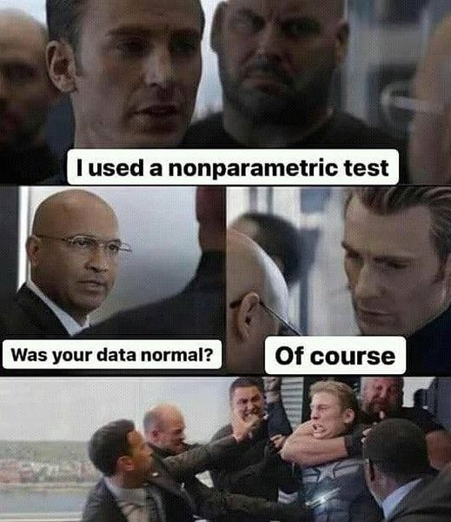


Non-parametric tests
MSc. Kian Jenab
PhD student
Devision of Terrestrial Ecosystem Research
Centre for Microbiology and Environmental Systems Science
University of Vienna
Email: kian.jenab@univie.ac.at

Slide 2
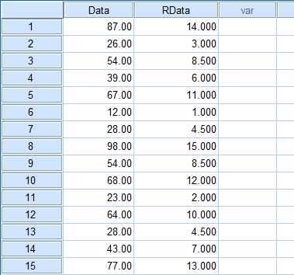
Non-Parametric Tests
Distribution-free tests
Based on rank
Not robust like parametric tests

Slide 3
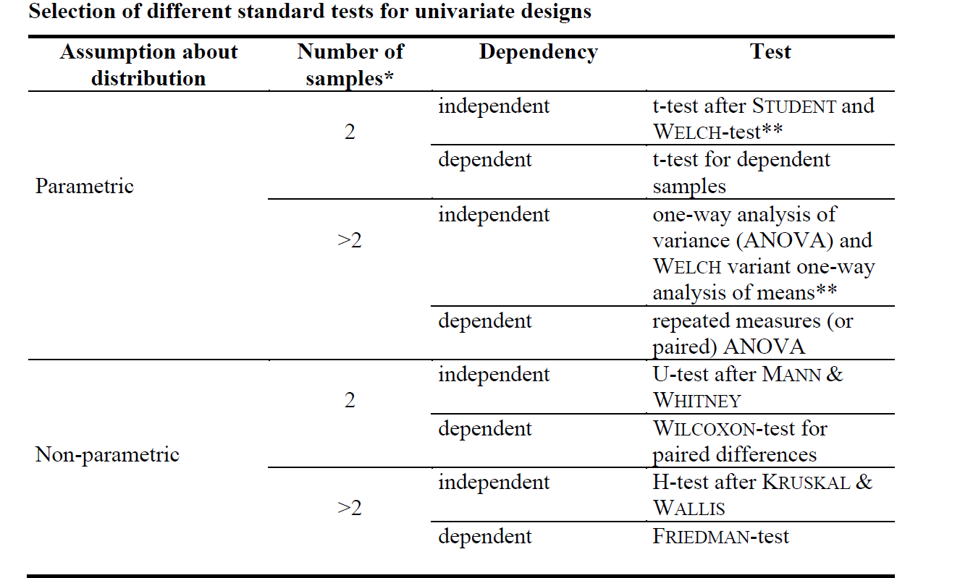

Slide 4
Mann-Whitney U-test

Slide 5
Wilcoxon Signed-Rank Test

Slide 6
Kruskal & Wallis H-test

Slide 7
Friedman-Test

Slide 8


Slide 9
Chi-Square Test for Independence
Relationship between two categorical variables
H₀: There is not significant relationship between two categorical variables
P > or = 0.05
H_{A}: There is significant relationship between two categorical variables
P < 0.05
Example: Relationship between smoking marijuana and cancer
Marijuana : Yes and no
Cancer: Yes and no

Slide 10
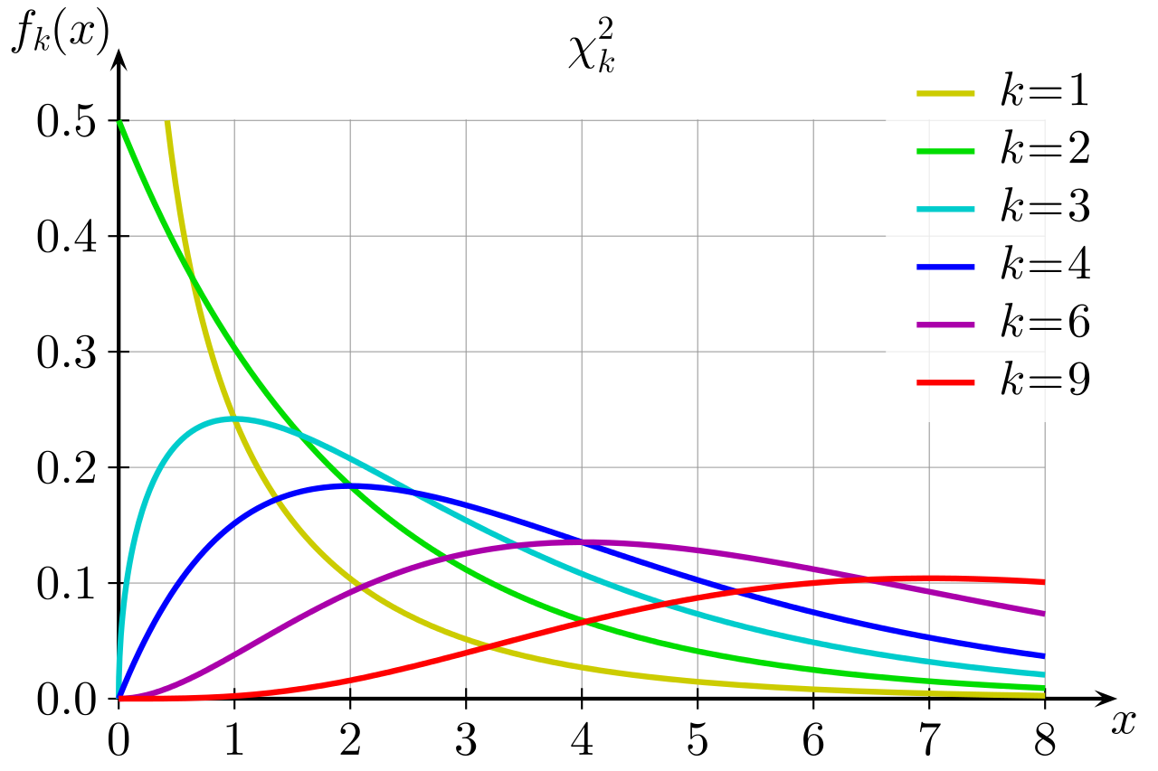
Chi-square distribution (χ2)

Slide 11
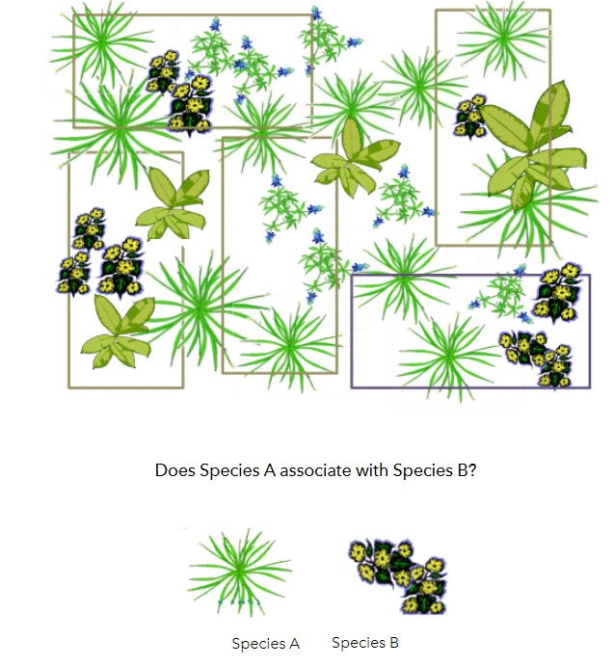

Slide 12
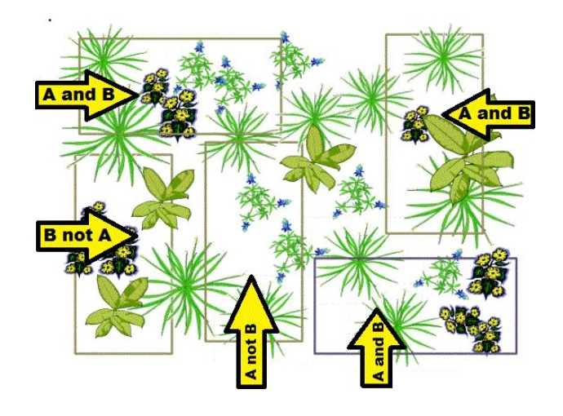

Slide 13
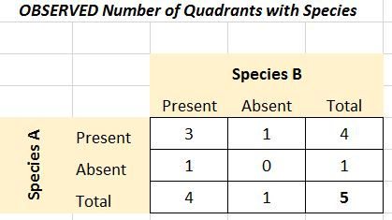
Contingency Table

Slide 14
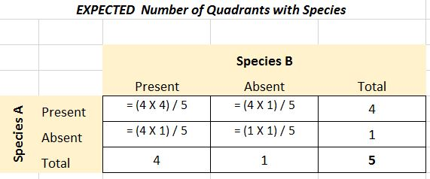
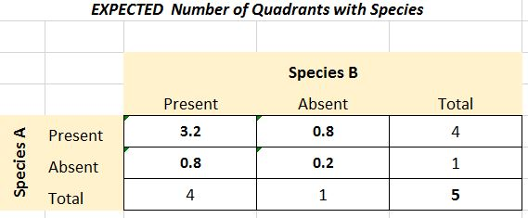
Expected frequencies = (row total X column total) / grand total

Slide 15
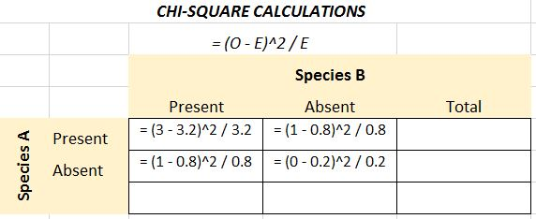
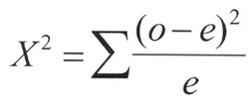
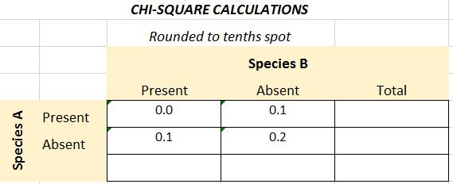
o = observed values
e = expected values
df = (number of rows - 1) * (number of columns - 1) df = (2-1) * (2-1) = 1*1 = 1
X² = 0.0 + 0.1 = 0.1 + 0.2 = 0.4

Slide 16
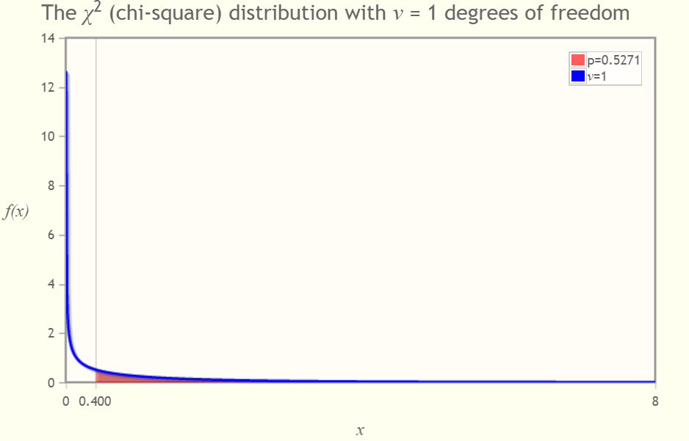

Slide 17
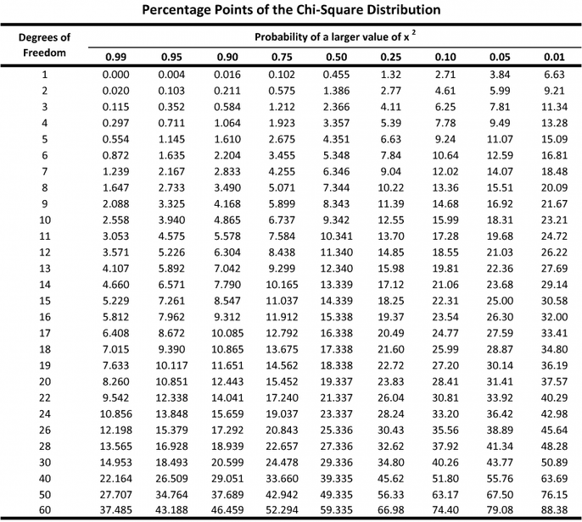
with a DF=1, a value greater than 3.841 is required to be considered statistically significant (at p = 0.05). Since the X² we calculated (0.4) is less than 3.841, there is NOT a significant association between Species A and Species B

Slide 18

Association Between Two Nominal Variables
Phi coefficient
Between 0 and 1
2*2 tables
Cramer's V
Between 0 and 1
More than 2x2 rows and columns

Slide 19


